Slide 1

CLI (Common Language Infrastructure)
Sit Dolor Amet

Slide 2
The Common Language Infrastructure (CLI) is an open specification (technical standard) developed by Microsoft and standardized by ISO and Ecma that describes executable code and a runtime environment that allows multiple high-level languages to be used on different computer platforms without being rewritten for specific architectures.
https://en.wikipedia.org/wiki/Common_Language_Infrastructure

Slide 3
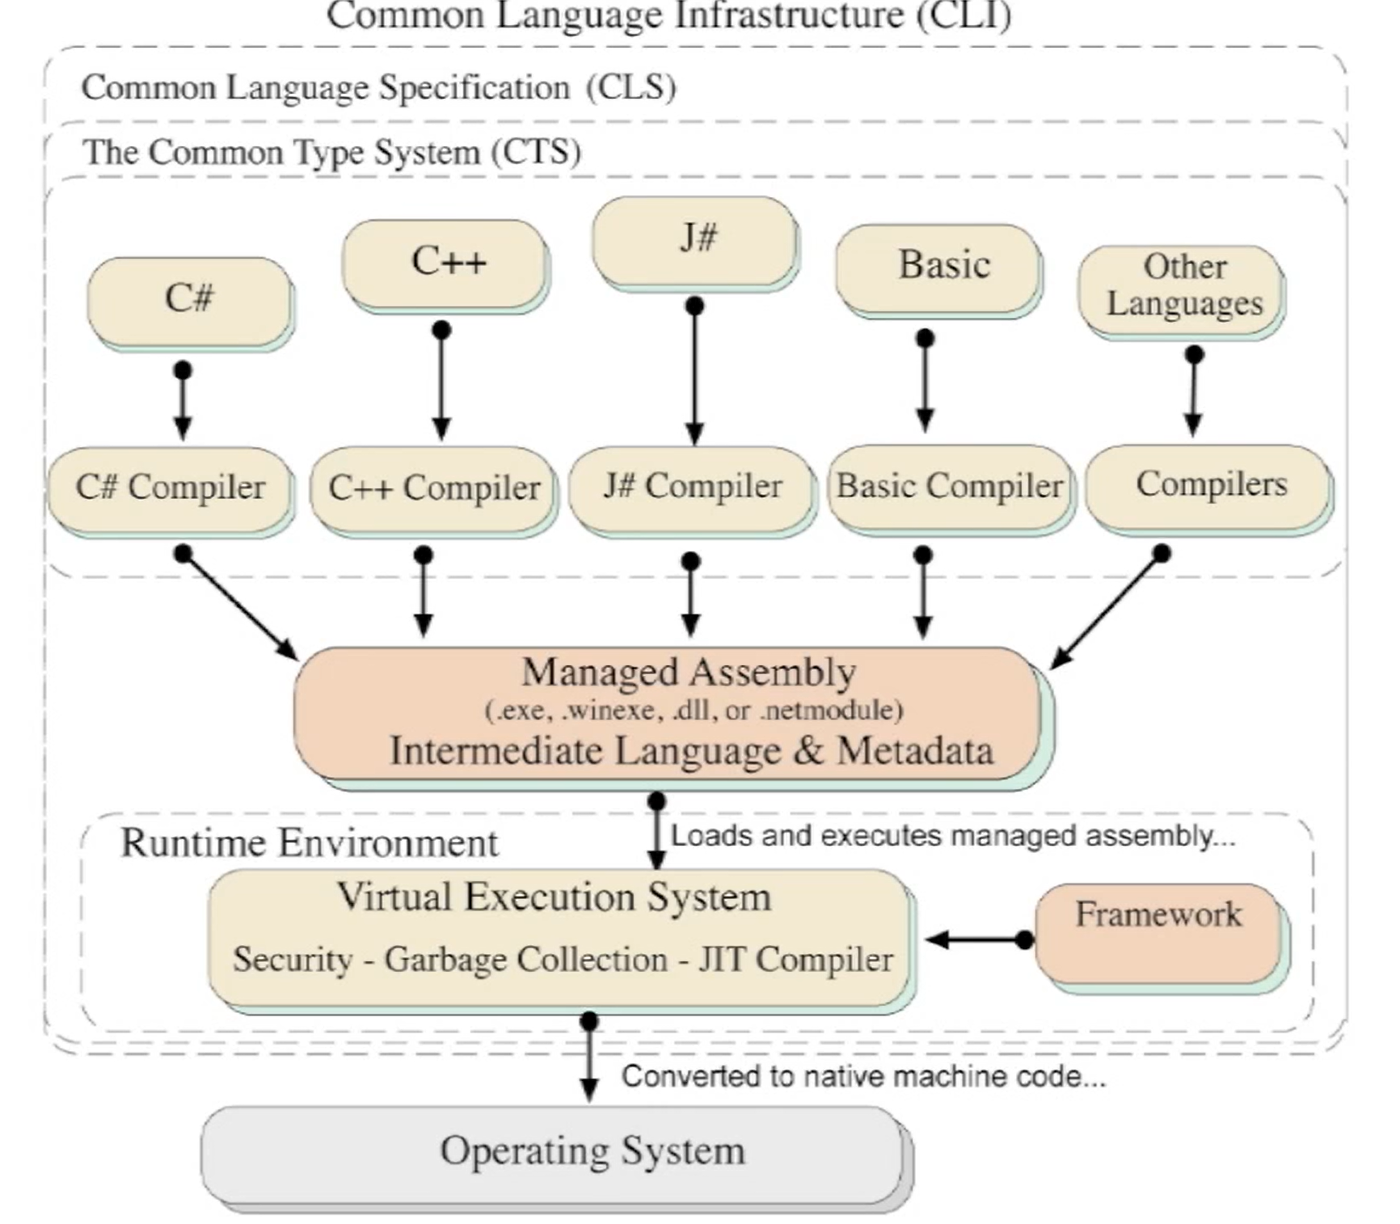
CLI (Common Language Infrastructure) https://searchapparchitecture.techtarget.com/definition/Common-Language-Infrastructure-CLI
Part of Microsoft's .NET strategy, Common Language Infrastructure (CLI) enables an application program written in any of several commonly-used programming languages to be run on any operating system using a common runtime program rather than a language-specific one. Common Language Infrastructure provides a virtual execution environment comparable to the one provided by Sun Microsystems for Java programs.

Slide 4
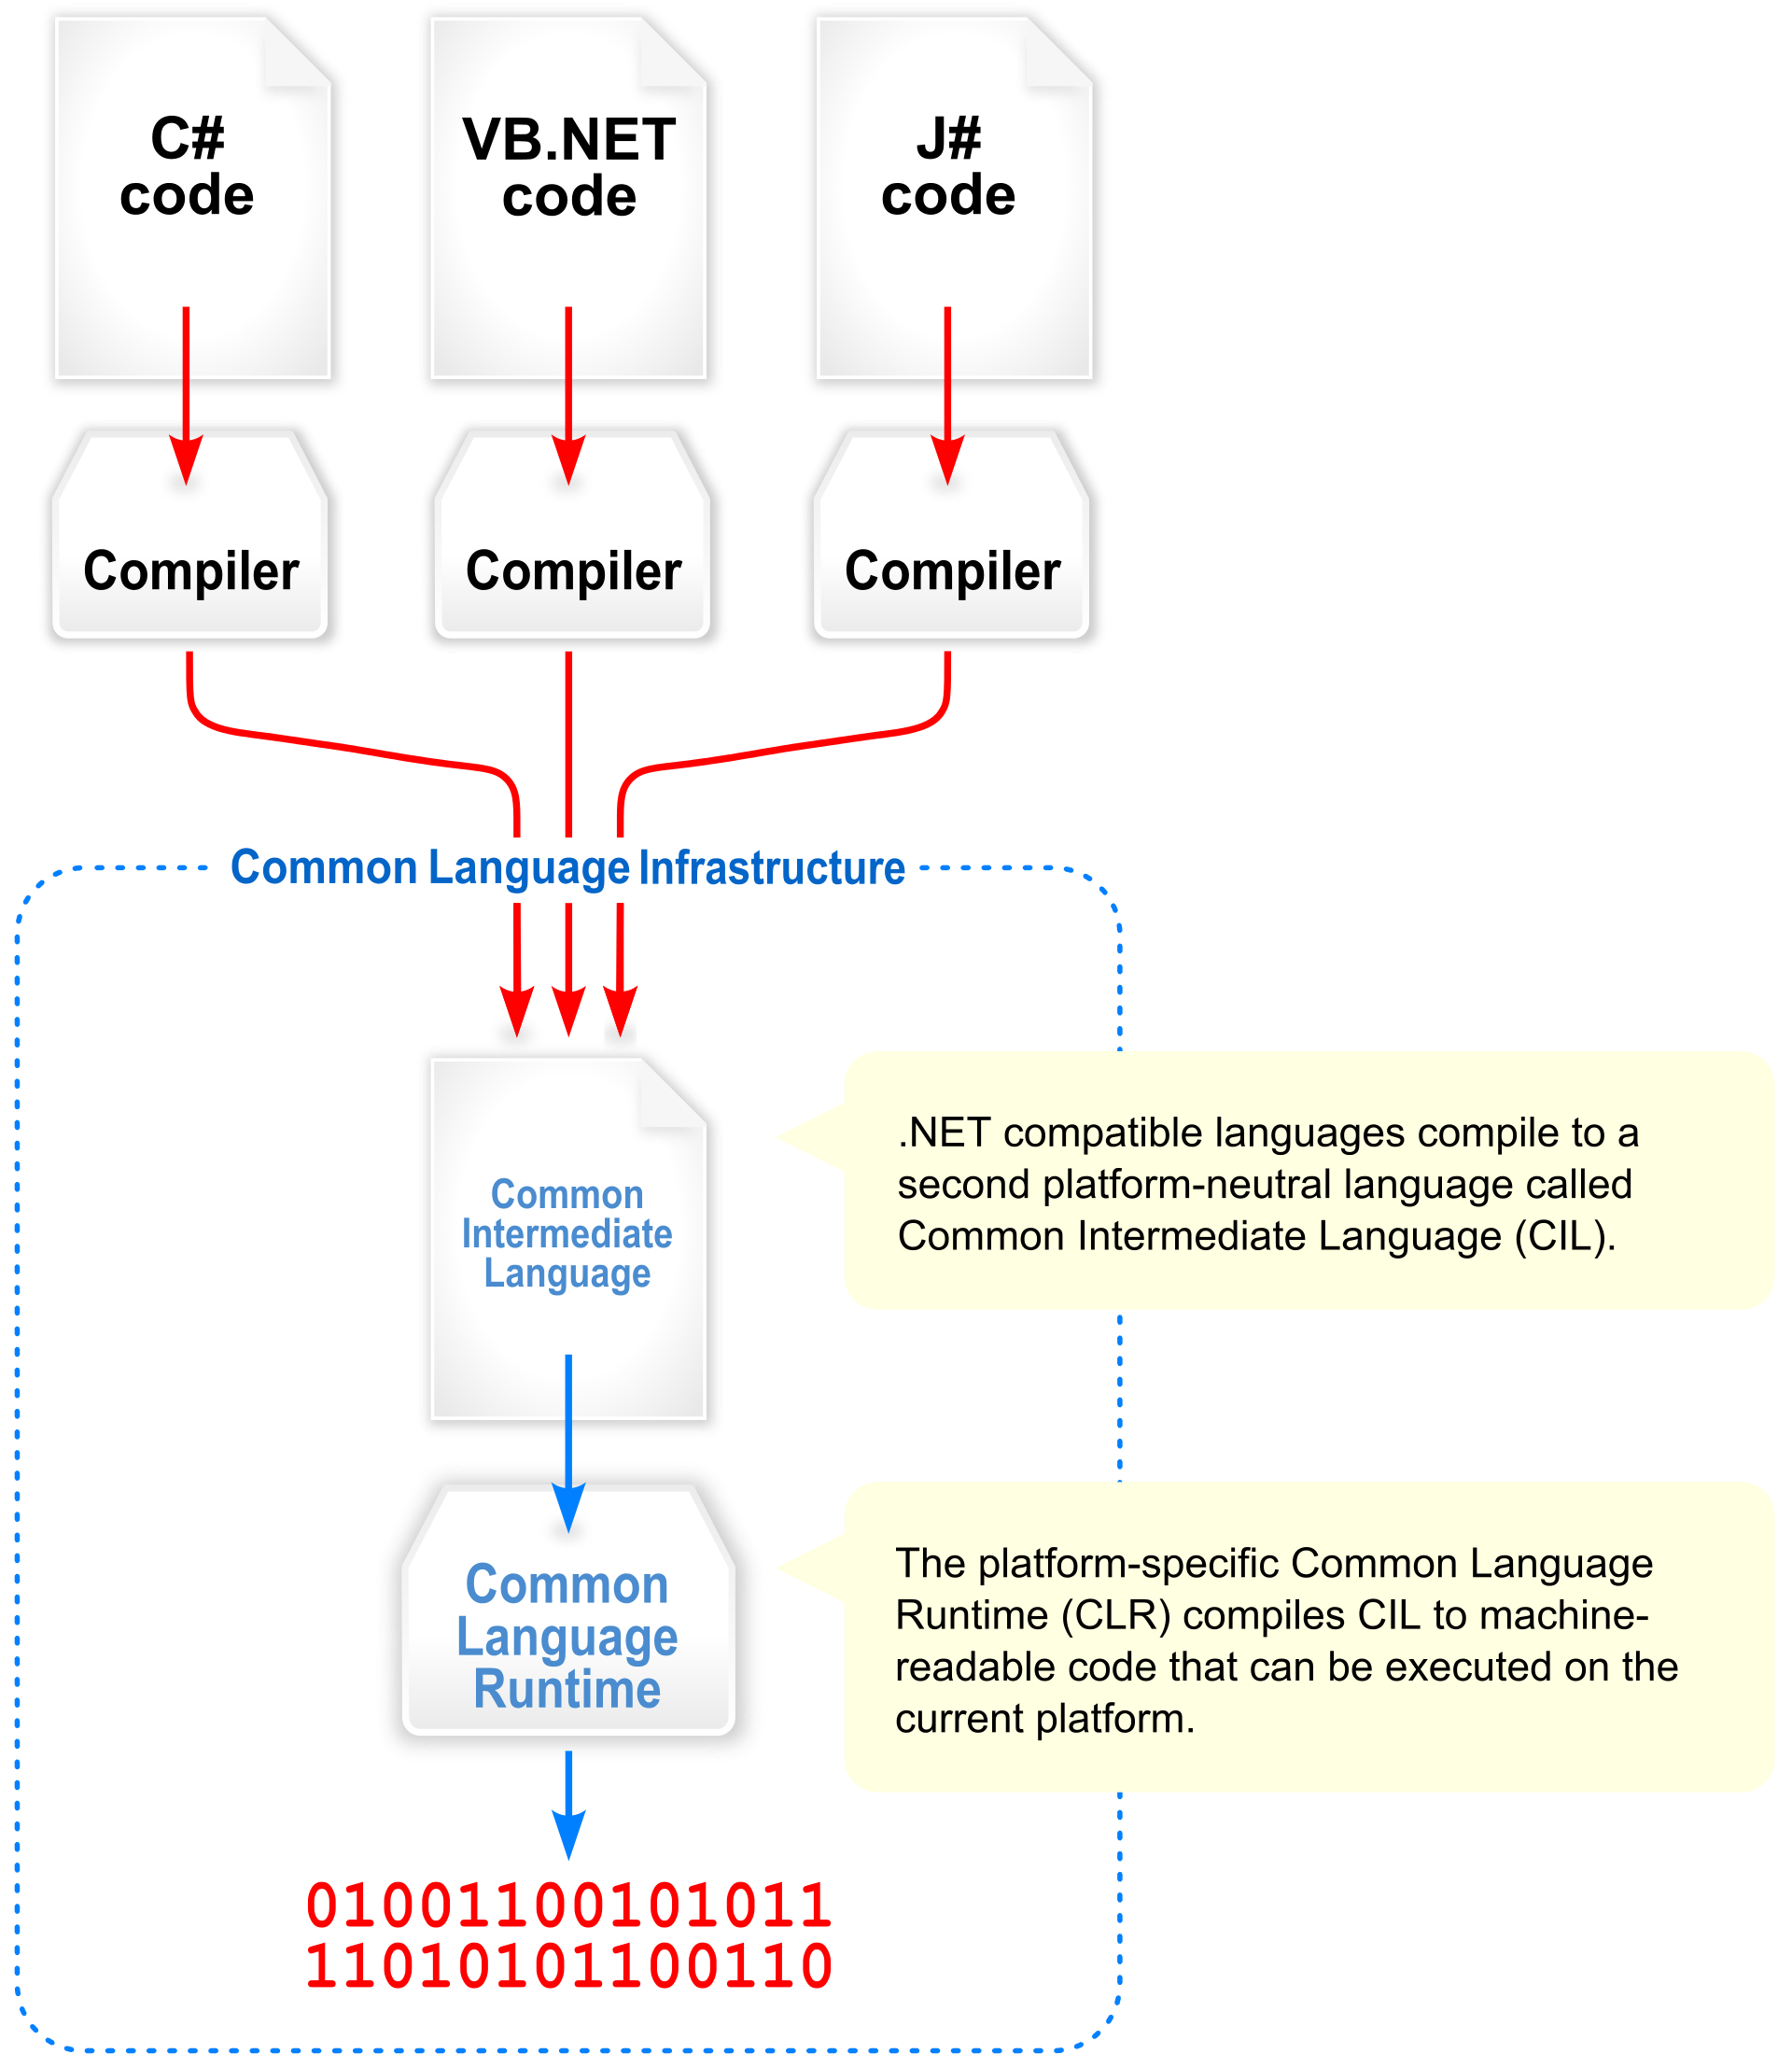
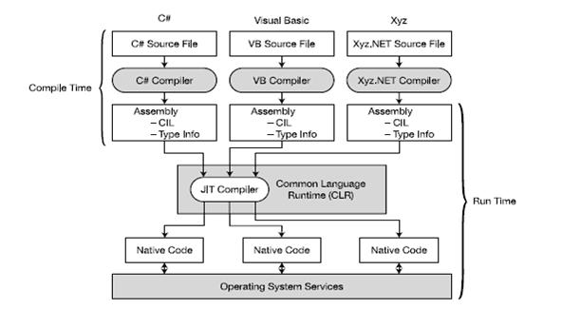
CLI (Common Language Infrastructure) https://docs.microsoft.com/en-us/dotnet/standard/managed-execution-process

Slide 5
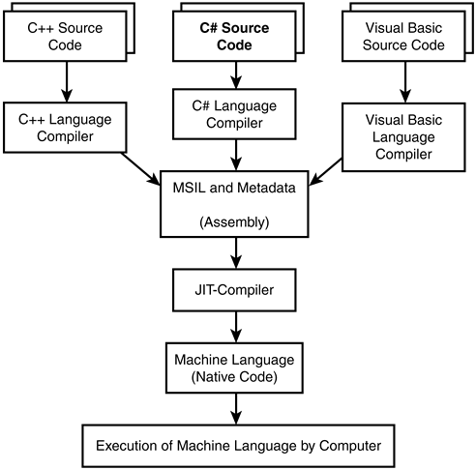
CLI (Common Language Infrastructure) - Two views, one model https://docs.microsoft.com/en-us/dotnet/standard/managed-execution-process

Slide 6
CTS (Common Type System) https://docs.microsoft.com/en-us/dotnet/standard/common-type-system https://docs.microsoft.com/en-us/dotnet/framework/get-started/overview https://www.youtube.com/watch?v=b7L03h7nMwg
The CTS is used by the CLR to enforce strict type-and-code-verification.
To ensure that the various Microsoft and third-party language compilers generate managed code that conforms to the CTS, the CTS:
describes all data types and all related constructs which are supported by the CLR
details how they must be represented in the .NET metadata format
specifies how entities can interact with each other
This means that managed code can consume other managed types and instances, while strictly enforcing type fidelity and type safety.

Slide 7
CTS (Common Type System) https://docs.microsoft.com/en-us/dotnet/standard/common-type-system https://www.youtube.com/watch?v=b7L03h7nMwg
The CTS provides a library of the basic primitive data types to be used in application development. This creates an Object-Oriented Model that implementing languages must follow.
CTS defines the two main kinds of types (reference and value types) that should be supported.
CTS defines several categories of types, each with their specific semantics and usage:
CTS defines all other properties of the types (access modifiers, valid type members, how inheritance and overloading works, etc).
Classes | Structs | Enums | Interfaces | Delegates

Slide 8
CLS (Common Language Specification) https://docs.microsoft.com/en-us/dotnet/standard/common-type-system
CLS is a subset of CTS
Since there are numerous different languages, .NET has specified the commonalities required to enable full interoperability between languages into something called the Common Language Specification (CLS).
CLS defines a set of features that are needed by many common applications. It also defines a set of rules and restrictions that every language must follow which runs under the .NET framework. It provides a sort of recipe for any language that is implemented on top of .NET on what it must support.

Slide 9
CIL (Common Intermediate Language) https://docs.microsoft.com/en-us/dotnet/standard/managed-execution-process#compiling-to-msil
Common Intermediate Language (CIL), formerly called Microsoft Intermediate Language (MSIL) or Intermediate Language (IL). CIL is the intermediate language binary instruction set defined within the Common Language Infrastructure (CLI). CIL instructions are executed by a CLI-compatible runtime environment such as the Common Language Runtime. Languages which target the CLI compile to CIL. CIL is object-oriented, stack-based bytecode. Runtimes typically Just-In-Time(JIT) compile CIL instructions into native code.

Slide 10
JIT (Just In Time Compiler) https://docs.microsoft.com/en-us/dotnet/standard/managed-execution-process https://docs.microsoft.com/en-us/dotnet/standard/managed-execution-process#compilation-by-the-jit-compiler
Just-In-Time (JIT) compilation (AKA, dynamic translation, AKA, run-time compilations) involves compilation during execution of a program (at run time) rather than before execution.
JIT compilation assumes that some code might never be called during execution. Instead of using time and memory to convert all the MSIL in a PE (portable executable) file to native code, it converts the MSIL as needed during execution and stores the resulting native code in memory so that it is accessible for subsequent calls in the context of that process.

Slide 11
VES (Virtual Execution System) https://en.wikipedia.org/wiki/Virtual_Execution_System
A Virtual Execution System (VES) is a run-time system of a Common Language Infrastructure (CLI) which provides an environment for executing managed code where the Common Intermediate Language (CIL) instruction set can be executed.
The Common Language Runtime (CLR) is the .NET Framework's implementation of a VES. It provides direct support for a set of built-in data types. It defines:
a hypothetical machine with an associated machine model and state,
a set of control flow constructs, and
an exception handling model.
Other notable implementations of the CLI such as Mono and Portable.NET include their own VES implementations. The .NET Micro Framework includes the .NET Micro Framework Interpreter as their VES implementation.

